Slide 1
The Howlers
Lunar Madness
( Investigating the relationship between Erratic Behaviors and Moon Phases )

Slide 2





The Howlers
Sheila Mathews
Data Engineer
Research
Data Preparation & Cleansing
Documentation
Raymond Stover
Project Manager
Data Analyst
Documentation
Quality Assurance
Michael Brady
Data Scientist
Statistics & Visualizations
Normalizations
Data Analysis
Presentation
Zain Master
Business Analysis
Data Scientist
Data Analysis
Data Visualizations
The Full Moon
The main guy!

Slide 3
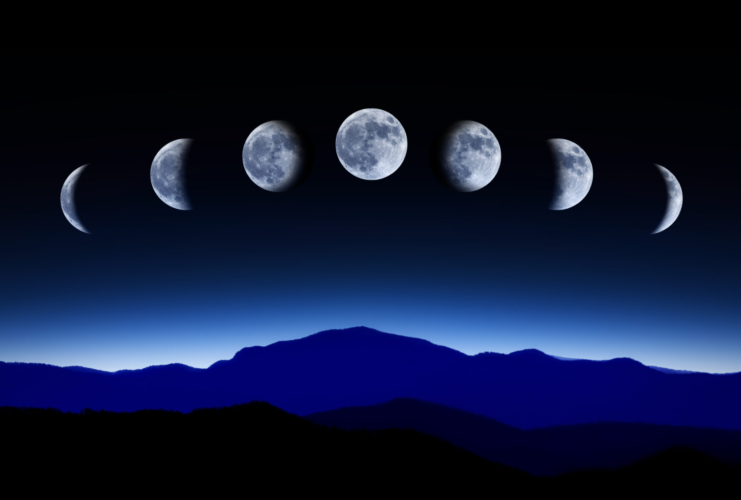
Hypothesis
Lunar Lunacy Effect
It’s a popular urban legend that the Full Moon causes people to behave erratically.
We wanted to prove or disprove the lunar lunacy effect by comparing crime data against the full moon in major metropolitan cities and traffic violations on Full Moon Days.

Slide 4
Approach
Hypothesis:
Higher volume of erratic behavior should be observable on days with Full Moon.
Erratic Behavior: Unpredictable, irregular, or inconsistent behavior that deviates from what is considered normal. It can include mood swings, impulsive actions, and exaggerated emotional responses.
Analogous dataset == Crime Data / Traffic Violations
Crime & Traffic Data ~ Moon Phases

Slide 5
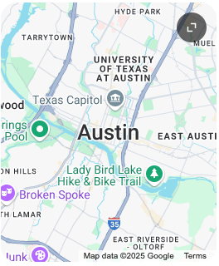
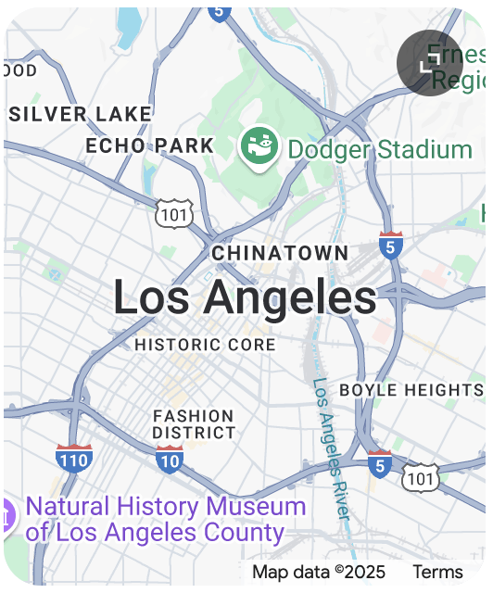
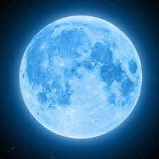
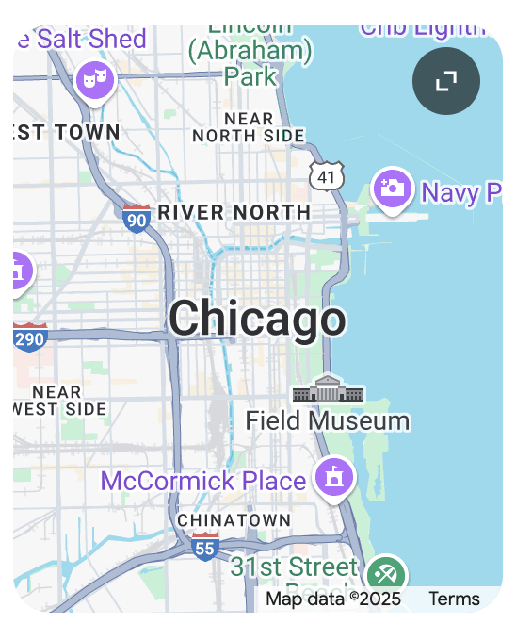
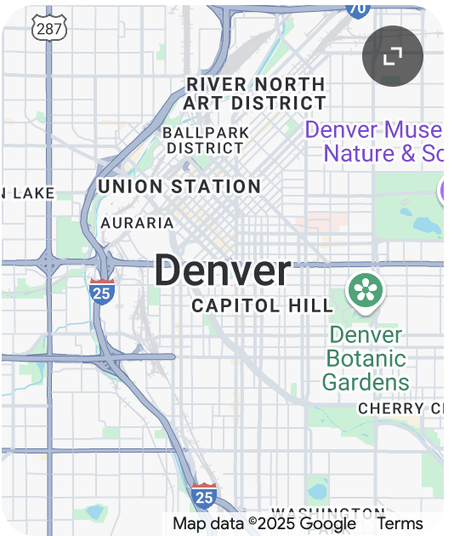
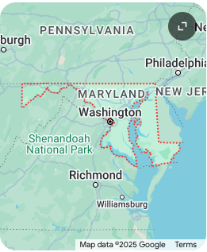
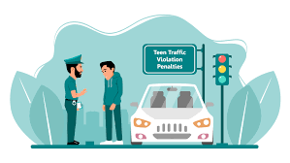
Full Moon vs. Crime & Traffic
Full Moon vs. Crime & Traffic
Moon Phase: Full Moon vs. Other (quarters + new)
Traffic: MD Traffic Violations (2015 - 2020)
Crime: 4 Major Metropolitan Crime Data Sets
Analysis:
Primary Dataset: Moon data | 2015 - 2024 (9 yrs)
2 Datasets (Crime & Traffic) merged w/ Moon Data
Crime Rate: Days w/ Full Moon vs. Other
Visualizations

Slide 6

Findings
TLDR
Unfortunately the Null Hypothesis came out ahead and our Alternate Hypothesis was not proven.
Null Hypothesis: Findings Indicated that there is NO relationship between the two variables:
Erratic Behavior (Crime / Traffic Violations)
Full Moon
Alt Hypothesis wasn't proven despite expanding to multiple cities

Slide 7
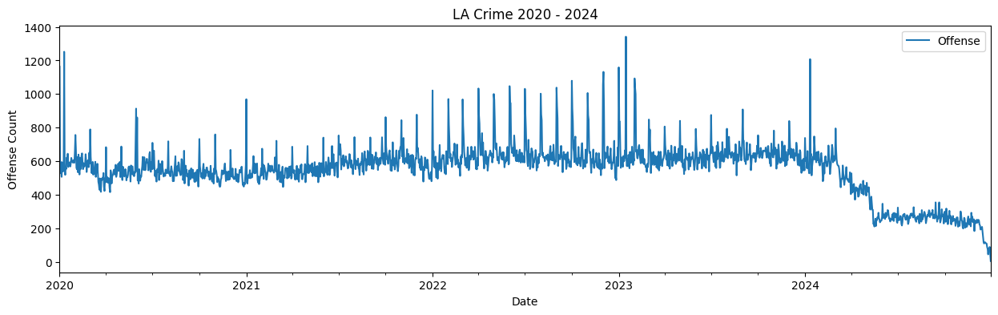
LA Crime Data
ETL Data
Cleaned and transformed (nan, datetime)
Columns: Date of Crime & Type of Crime
Visualized (groupby # of crimes on Date)
Observations
2024 > Crime Dropped Significantly
2022 to 2024 > Crime spike patterns
Corroborating News Article:
**KTLA News: L.A. homicides down slightly so far in 2024: report
Notes:
https://ktla.com/news/local-news/l-a-homicides-down-slightly-so-far-in-2024-report/

Slide 8
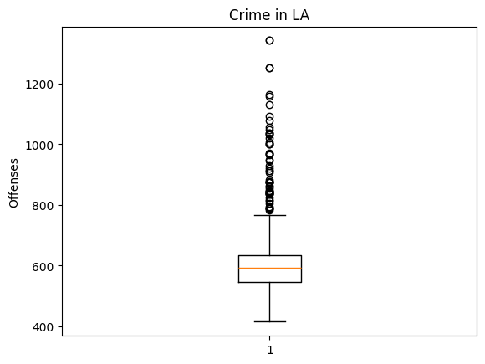
Identify Outliers
Normalized Crime Data
- Created a Control Dataset
- Removed:
- 2024 crime crackdown by LAPD
- Used Boxplot to identify Outliers
(Crime Spikes/Low’s)

Slide 9
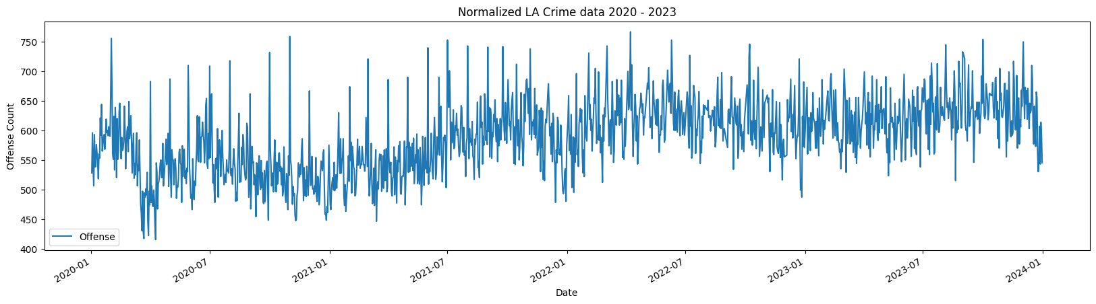

Normalized Crime Data

Slide 10
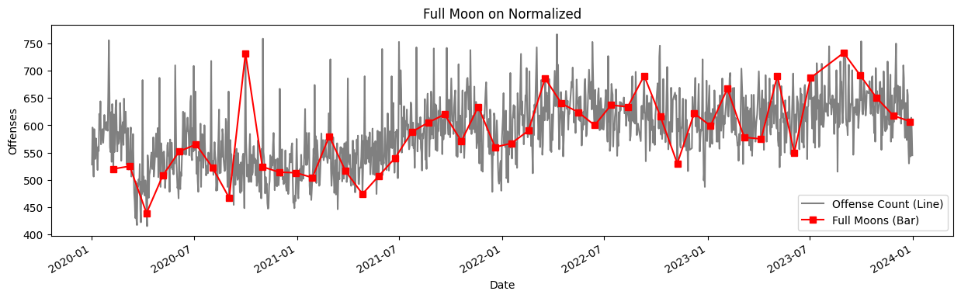
Full Moon vs. Crime
Superposition
Overlaying our Moon Data on top of Crime data shows no discernable pattern or relation.
Calculative Comparison
Avg (Full Moon Crimes)
Avg (Other Moon Crimes)
= 0.9982*
*When a ratio is close to 1, it means that the two quantities being compared are nearly equal to each other; essentially, there is a very small difference between the two values in the ratio

Slide 11
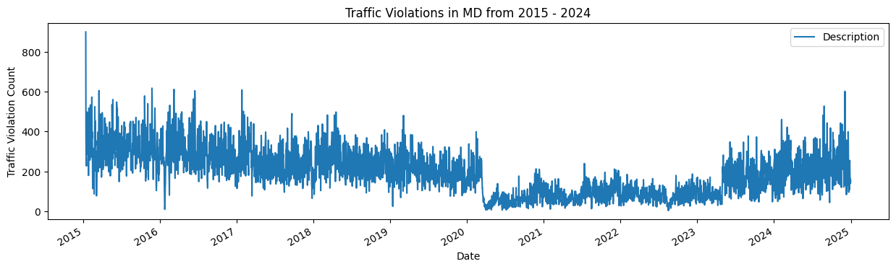
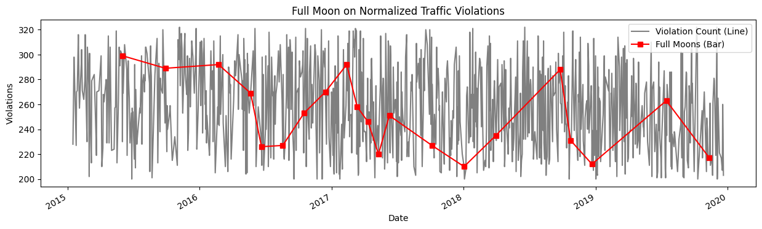
Traffic vs. Full Moon
Maryland Traffic Data
COVID
RTO
- Sliced data set to be only pre-covid
- Normalized it by removing outliers
- Overlaid with Moon Data
NULL HYPOTHESIS WINS AGAIN!

Slide 12
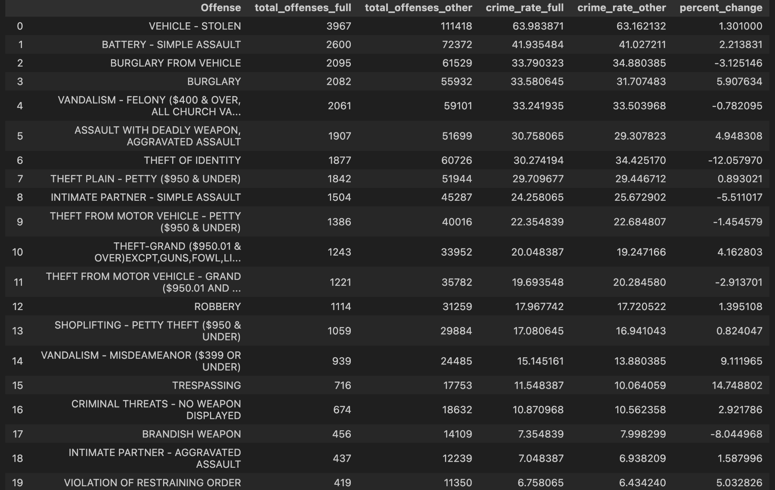
A Deeper Look at L.A.
Here’s a more granular look at data from Los Angeles, breaking down crime rates by offense.
Inquiries like this prompted investigation into specific offenses. See Jupyter Notebooks for details.
How can we account for findings which appear to confirm the lunar effect?
@MICHAEL SLIDES - Other cities data

Slide 13
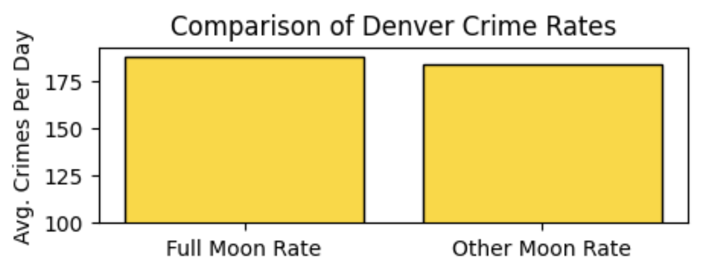
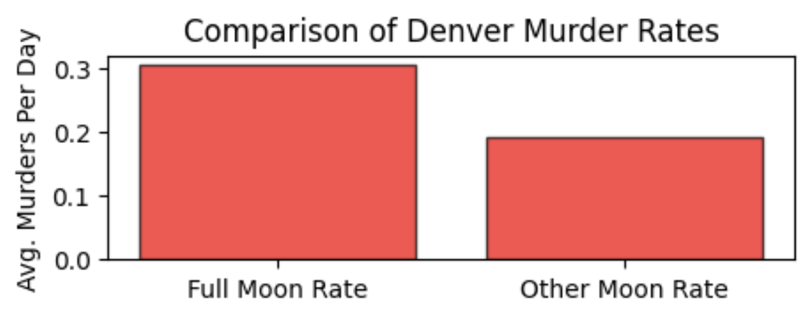
Austin, Chicago, Denver
Austin (2014 - 2023)
Shows essentially zero and even slightly negative correlation.
Chicago (2020 - 2022)
Again a slightly negative correlation, suggesting no meaningful relationship.
Assault rates require analysis.
Denver (2018 - 2023)
Shows a 2% increase in overall crime rate with a large sample size.
Shows a dramatic 58% increase in murder rate on a much smaller sample

Slide 14
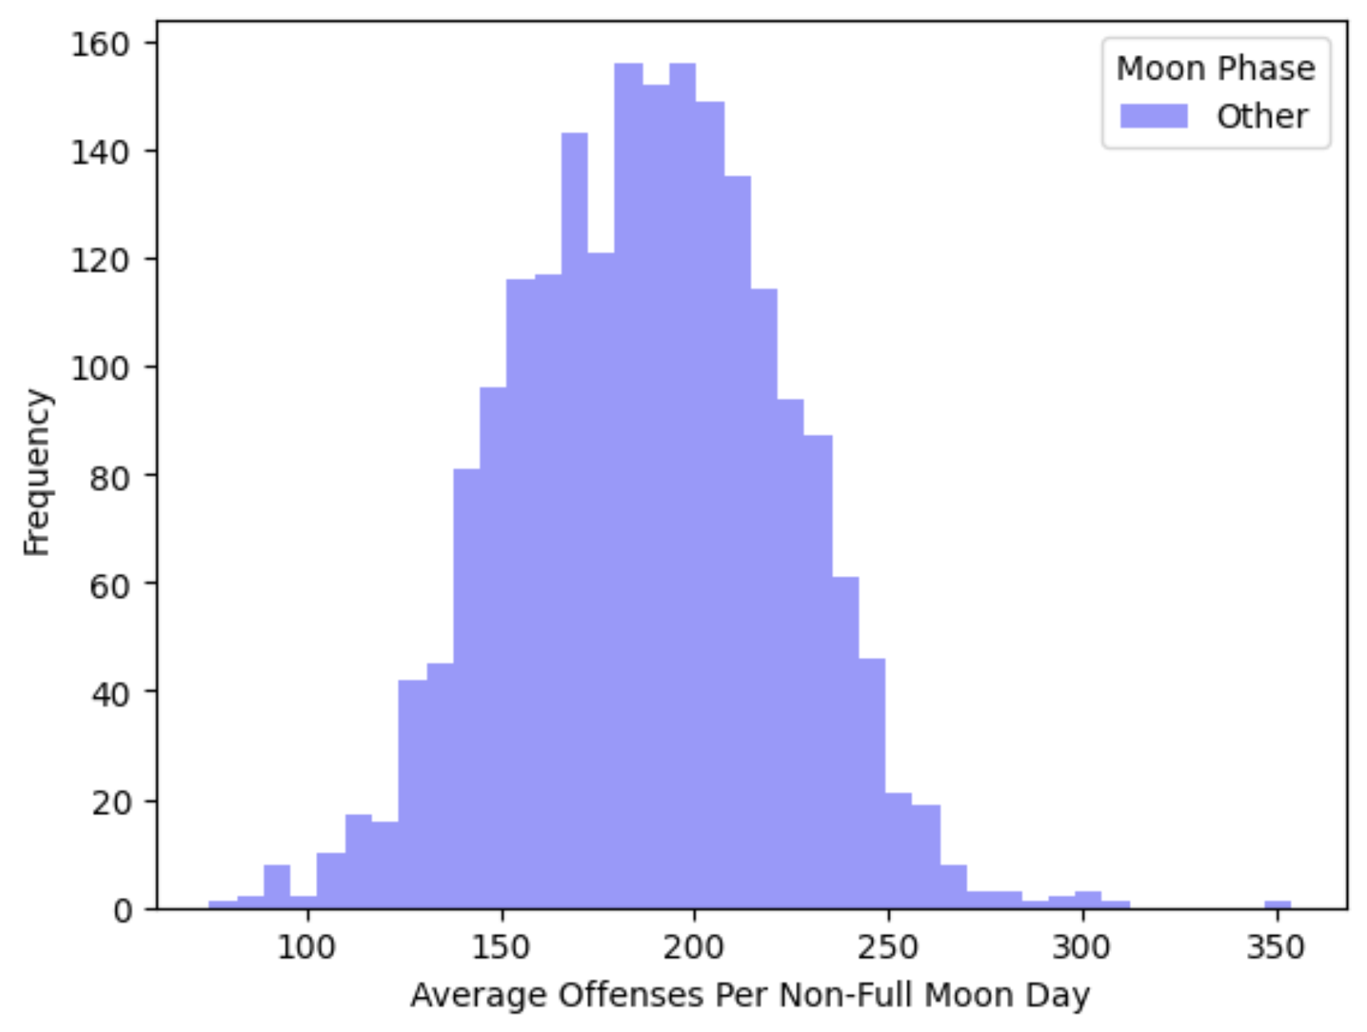
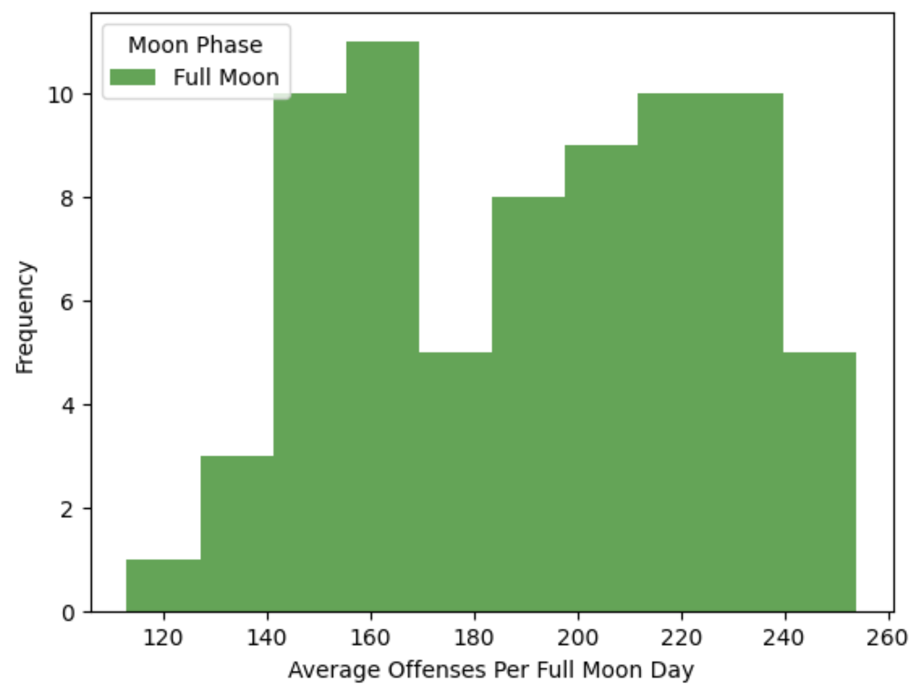
Denver Deep Dive
Handling two types of findings within the Denver data:
A 2% increase in crime for full moon days on a large sample size of approximately 380,000.
A 58% increase in murder for full moon days on a small sample size of approximately 400.
First, we’ve assessed which methods to use based on the distribution of data.
Is it normally distributed?
Figure one suggests maybe yes, but figure two looks like no. We will not use parametric methods.

Slide 15
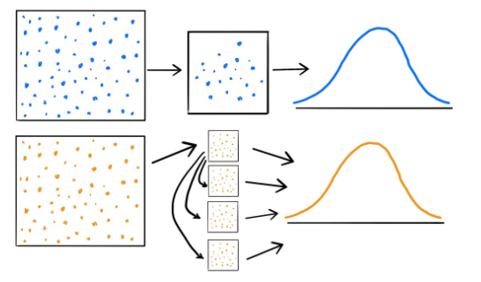
Confidence Interval (CI)
A method called bootstrapping allows us to simulate a much larger dataset without needing to assume a normal distribution.
个个八
For both the crime rate and the murder rate, we resampled our data 100,000 times to return a confidence interval and probability of directional relationship.
Murder Rate Increase:
95% CI = [-0.21, 0.32]
Probability of directional relationship: only 51%
(i.e. a coin flip)
Crime Rate Increase:
95% CI = [-3.9, 12.0]
Probability of directional relationship: 84%

Slide 16
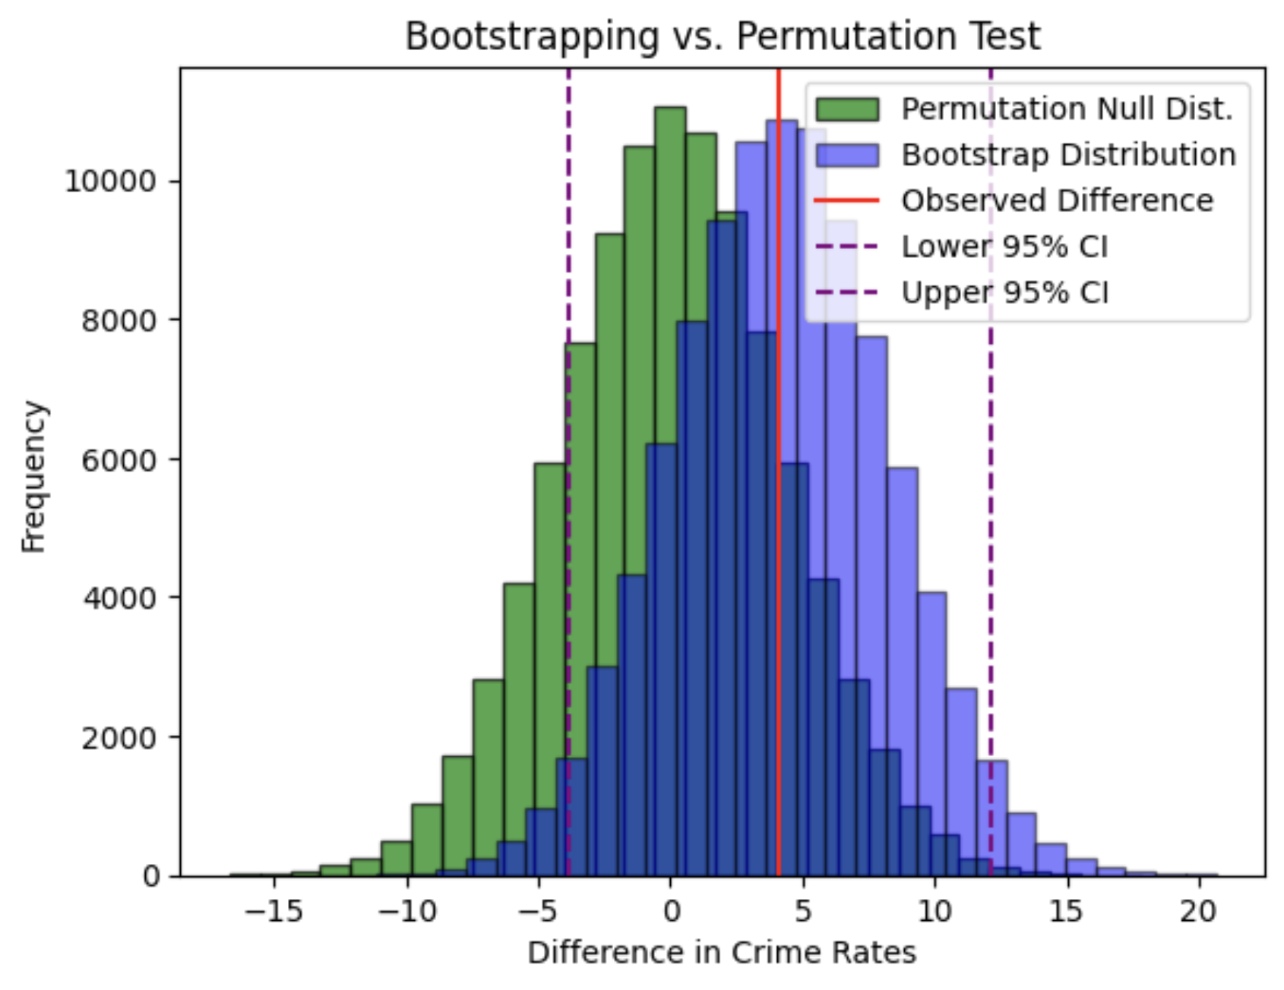
Permutation Test (P-Value)
While the murder rate increase hypothesis folded quickly under pressure from the resampling (bootstrapping), the overall crime rate continued to show promise.
A permutation test allows us to evaluate the null hypothesis by reshuffling the data randomly between both conditions; in this case: full moon vs. other.
“If we shuffle this data 100,000 times, how often would we observe an effect this strong purely by random chance?” We did this.
The answer? 33% of the time
Conclusion: This finding is not statistically significant.

Slide 17
Summary
Overall: Mean, Ratios, Statistical, Confidence Interval analyses all indicate a LOW to NO relationship between Erratic Behaviors (Crime & Traffic incidents) and Moon Phases
Null Hypothesis proved:
Full Moon Crimes / Divided by / Other Moon Phase Crime rates:
Tendency towards ‘1.0’ indicating LOW correlation
Permutation test Indicates 33% chance when Moon phases are compared
Lessons Learned:
Disparate data and small datasets can skew results
Unexpected patterns emerge and deserve additional research & validation
Opportunities exist for data mining with municipalities, regional service providers
Lunar Madness team is available for contract. Our team can hit the ground running with several models to plug in local and regional data to uncover statistical correlations that may save money, resources and lives

Slide 18
Q&A
?

Slide 19
Appendix
DATA SOURCES
Moon Data
US Naval Observatory
Metropolitan Cities | Crime Data
Los Angeles
Houston
Chicago
Denver
Austin
Traffic Violation Data
Maryland

Slide 20
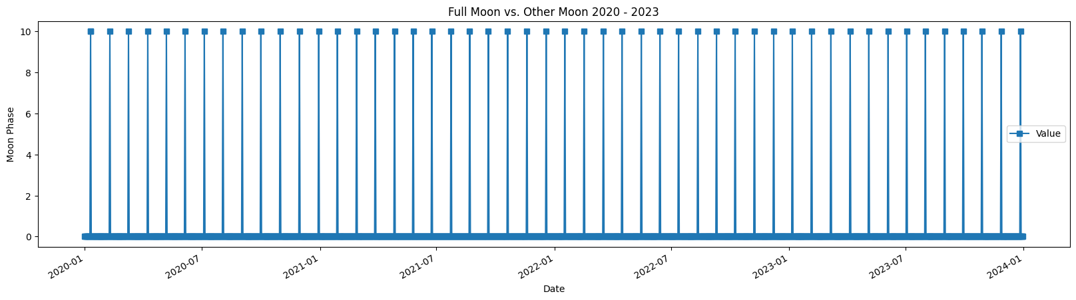
Moon Phase
Full Moon vs. Other
- Full moon = 10
- Other phases = 0
(quarter moons, new moon)

